Slide 1
Time series analysis
and forecasting of energy
demand with
Recurrent neural networks
MAP573
Ari JÓHANNESSON Francisco CORREIA Pedro MACEDO
Raphael MENDES

Slide 2
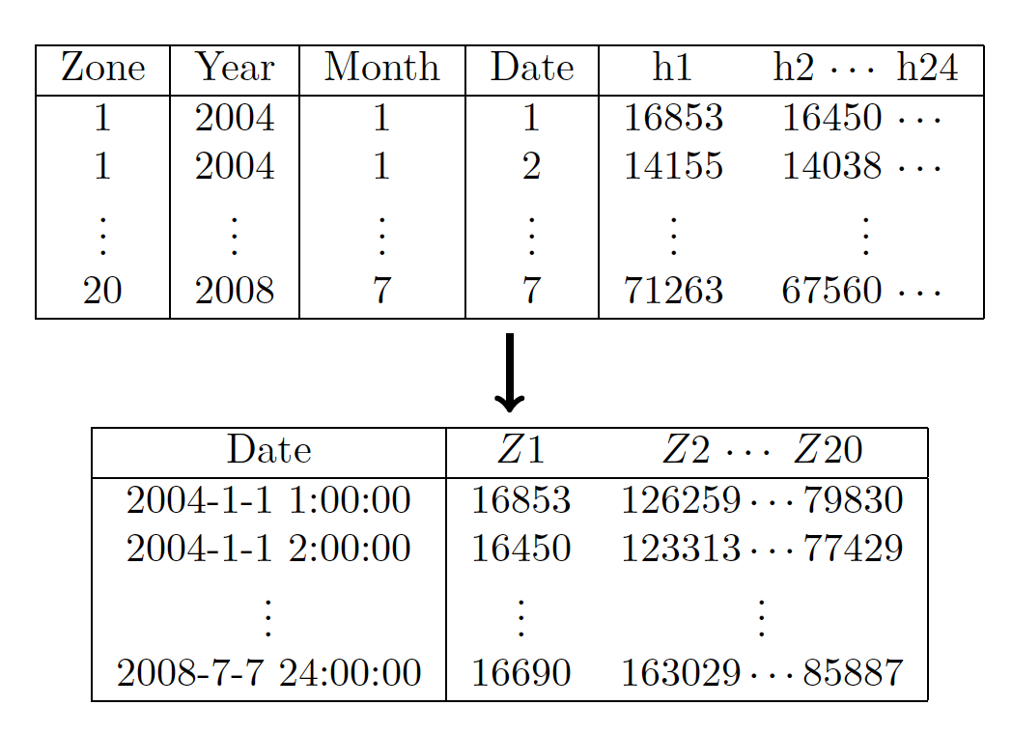
Data Transformation
Data had:
‘Non-practical’ format
Missing values
Zone 9 removed
Notes:
The data came in two csv files, one temperature data and other energy load data.
The first thing that we did was to transform the data to a more practical format for analysing time series.
Before transformation, the zones were separated as shown in the figure and we concatenated them such as for each hour we measurements for each zone.
Due to some strange behaviour zone 9 was removed for the prediction.
The data also had some missing values, more specifically missing weeks which we found online and inserted them in our dataset.

Slide 3
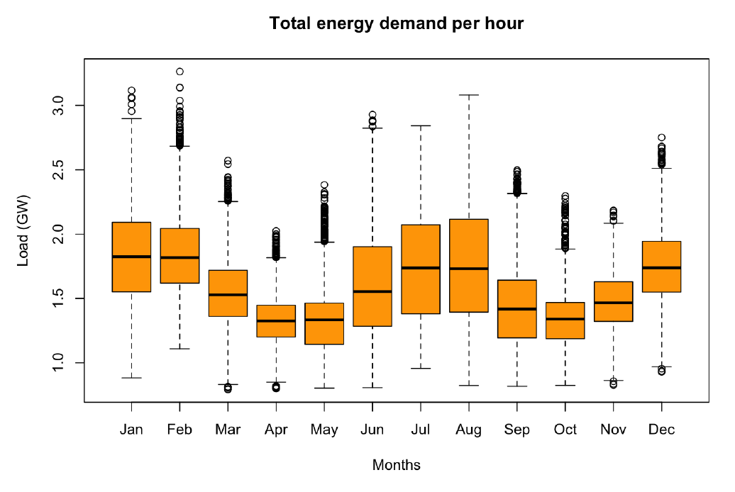
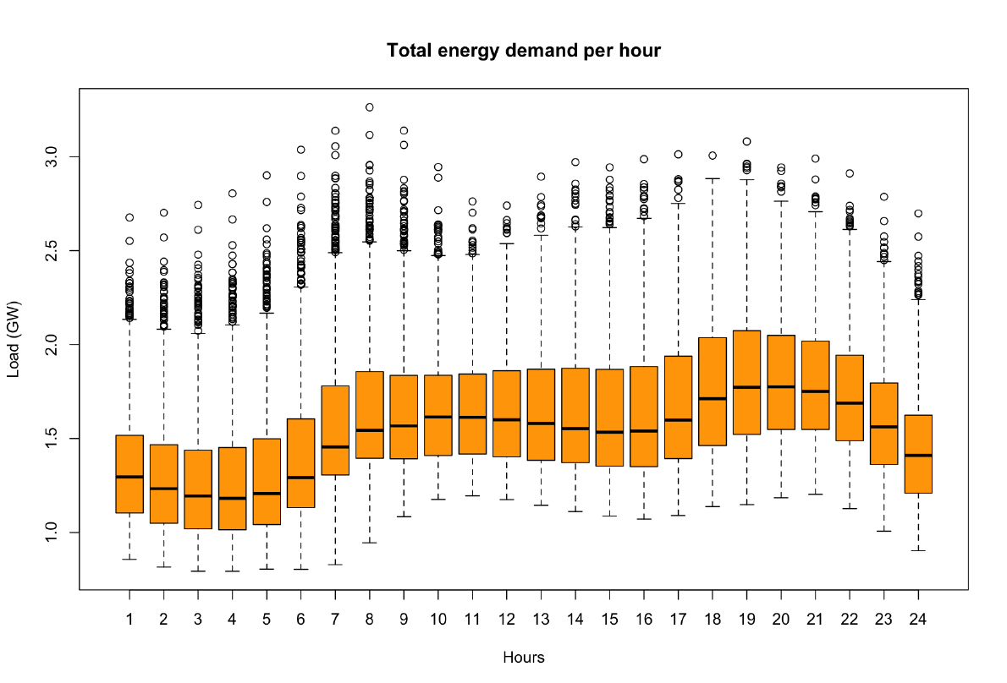
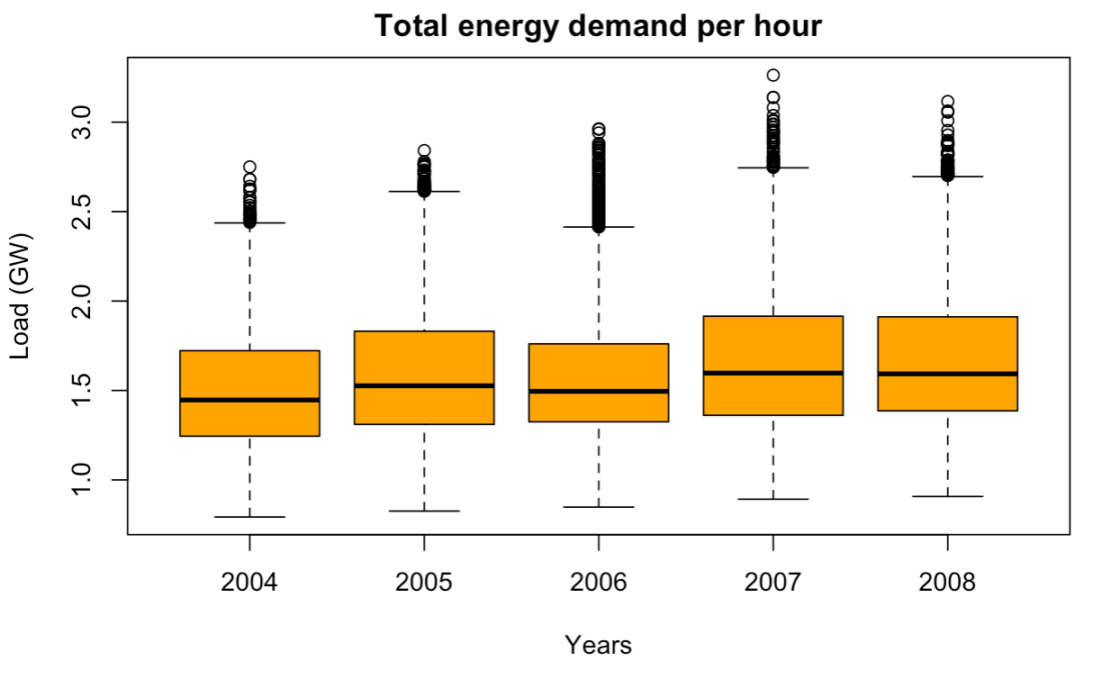
Data Statistics
Relationship between energy demand and temperature
Energy demand increases throughout the day
Years do not differ significantly
Notes:
One would expect energy demand to be correlated with temperature. This is exactly what we see in these figures. The energy demand seems to be higher in hotter and colder months than in other. The energy demand, not surprisingly, increases throughout the day and decreasing when we get closer to midnight.
Energy consumptions seems to be increasing slowly throughout the years but do not seem to differ significantly.

Slide 4
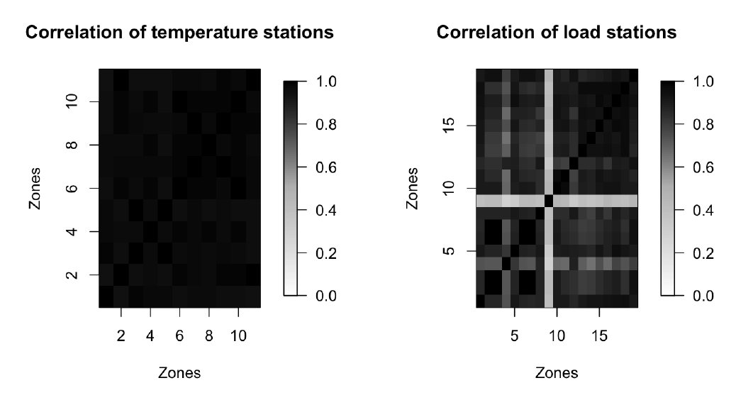
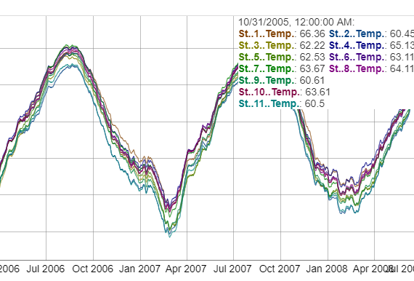
Zone Correlation
Temperature stations highly correlated
r = 0.97
Load stations correlate
On average r = 0.84
Except zone 8 (r = 0.4)
Notes:
We checked for correlation within the temperature stations and within the load stations.
What we found is that temperature stations are highly correlated with an average correlation coefficient 0.97.
The load stations were less correlated but averaged around 0.84. The only zone deviated itself from the others was zone 8.

Slide 5
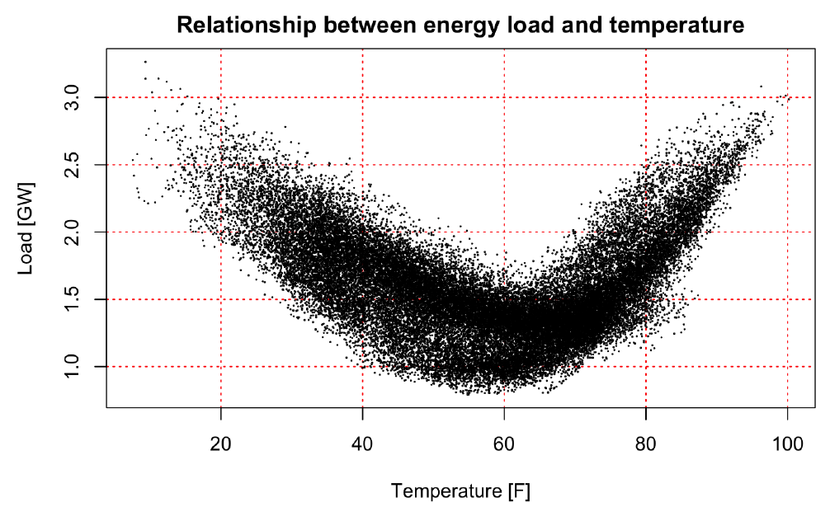
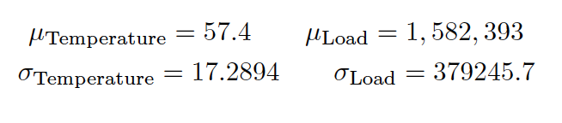
Energy Demand and Temperature
Further evidence of correlation between energy demand and temperature
Hot/cold months have higher demand
Notes:
Here we see again the relationship between the temperature and energy demand.
What we did is we took the average of the temperature for each hour and the total energy load for each hour.
From this we did a scatterplot which clearly shows that with lower or higher temperature, energy demand increases.

Slide 6
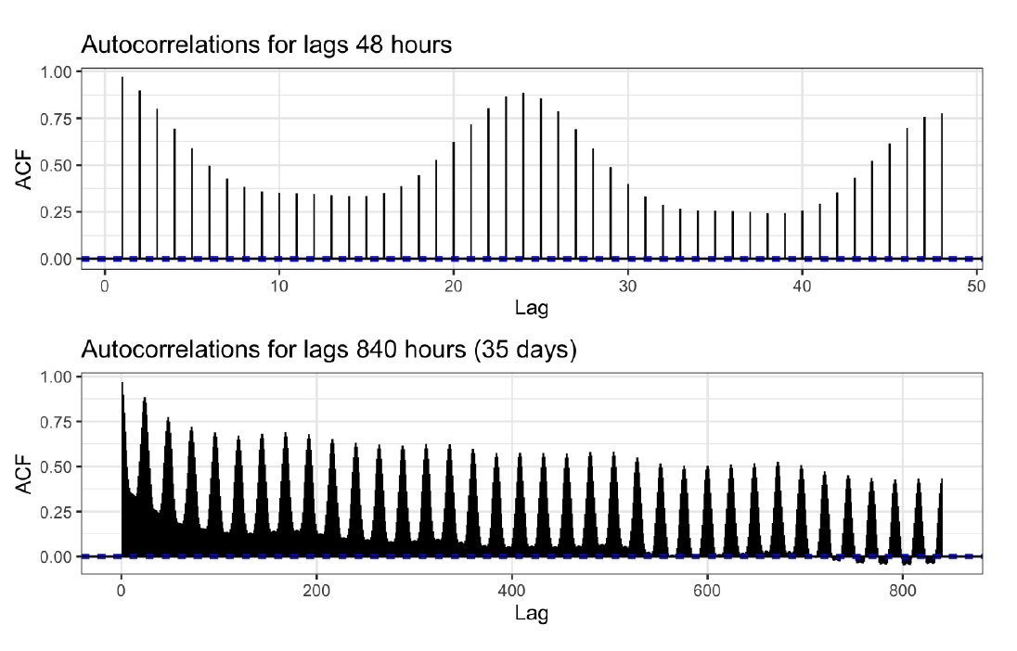
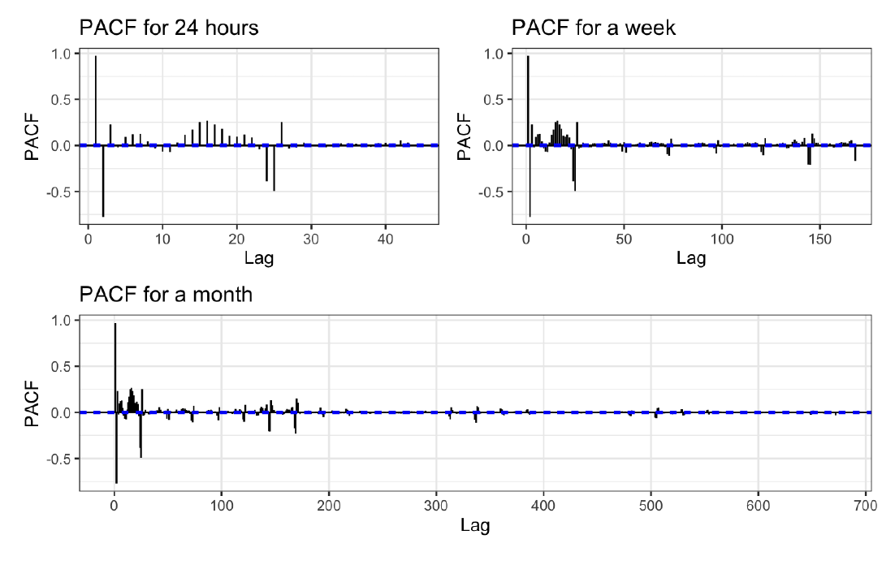
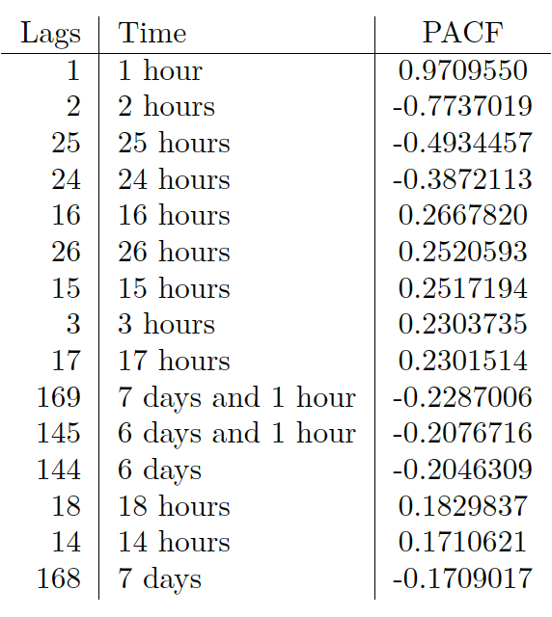
ACF and PACF
ACF: Correlation of a time series with delayed copy of itself as a function of delay
PACF: Controls for other lags
Notes:
Energy data often has seasonality for days, hours, weeks or even years.
To check for seasonality in the data, we did autocorrelation on it. The top plot indicates a seasonal period of 24 hours.
If the lags are extended the autocorrelation can be seen decreasing with time but every 6-7 days it increases slightly, indicating that there is some kind of a weekly seasonality also.
This can also be seen in the bottom figures where partial autocorrelation is taken. Here the 24 hours partial autocorrelation can be seen. Here the first week, the first 24 hours having the most partial autocorrelation but the correlation appearing every 24 hours. Same can be seen for month….

Slide 7
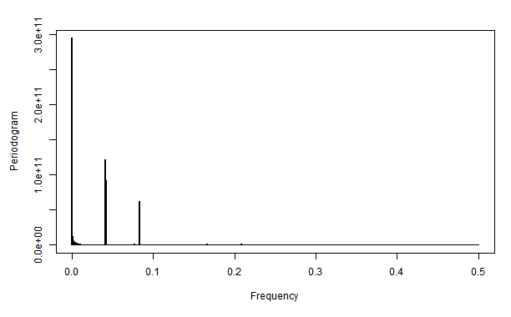
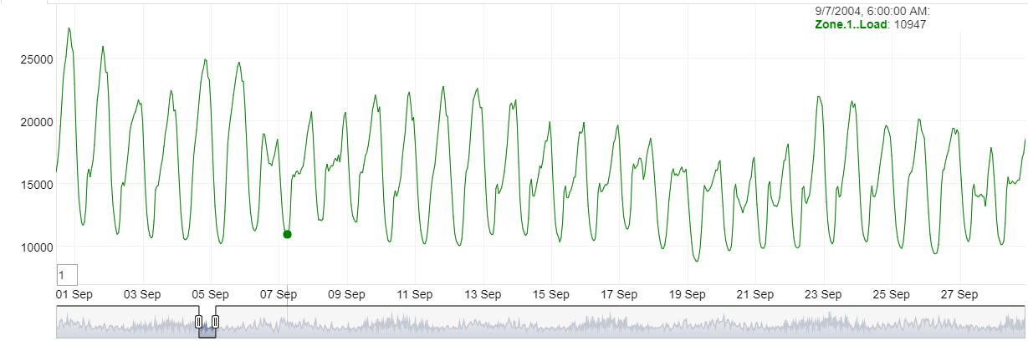
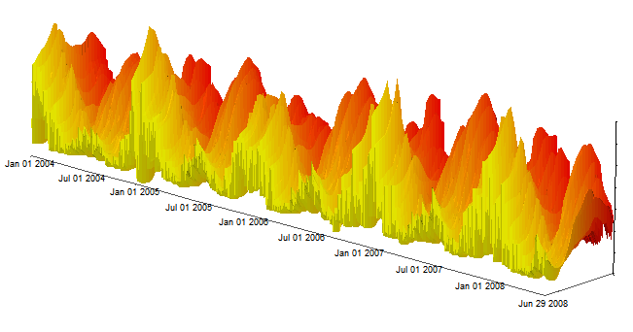
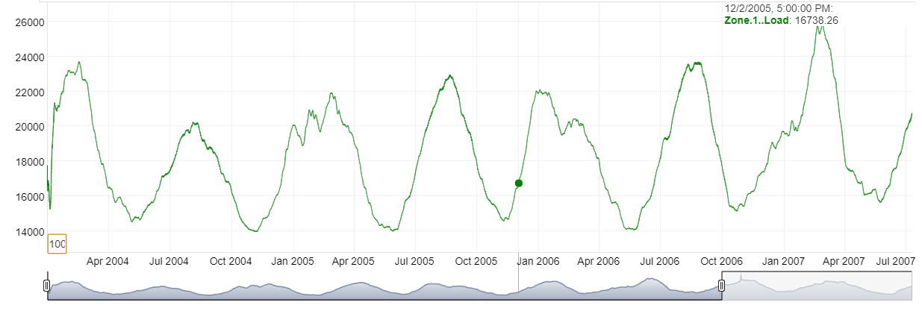
Fourier Analysis- Extracting Seasonalities
Data of Zone Load 1. In the bottom left corner, showing 1 point each 1000 anothers

Slide 8
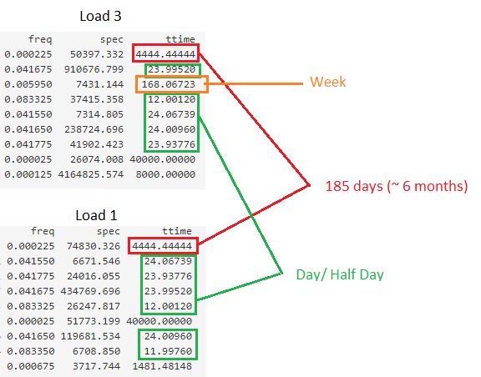
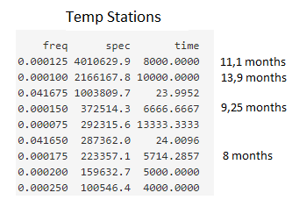
Fourier Analysis
Data of Load zones and temperatures stations have similar spectral patterns:

Slide 9
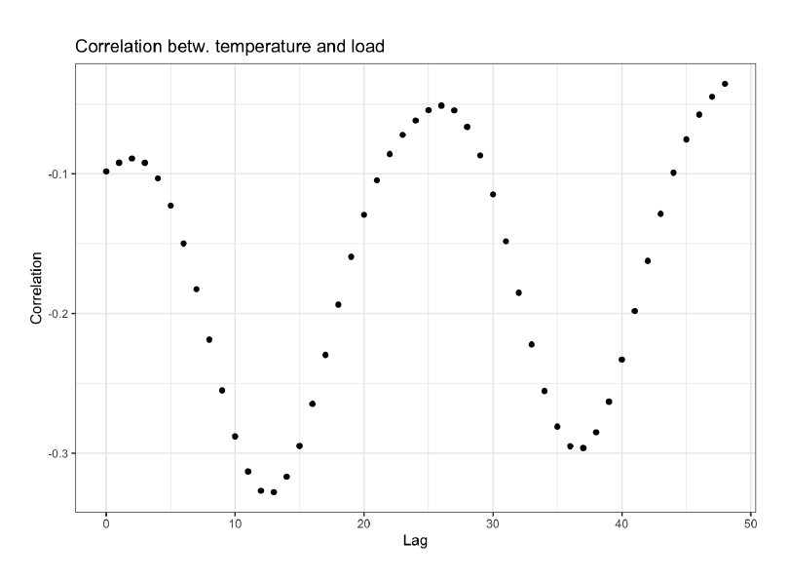
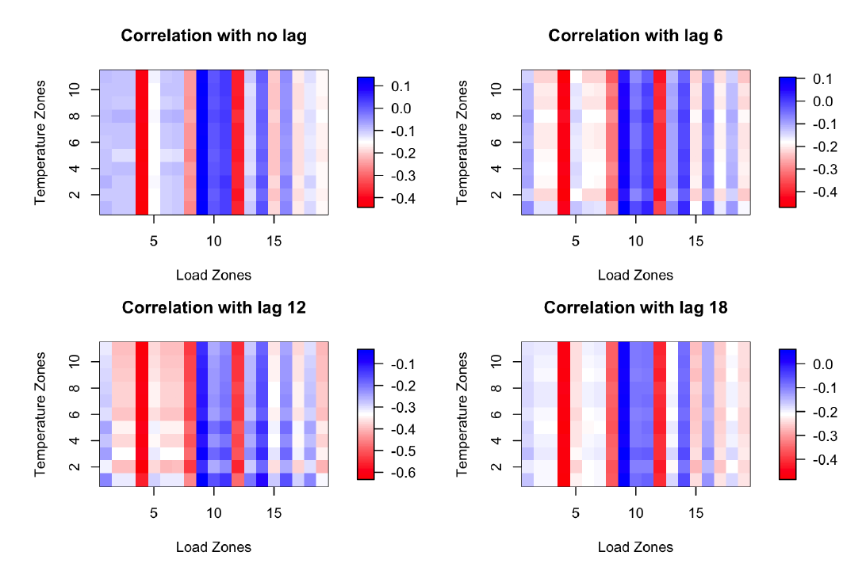
The Recency Effect
Energy demand partially determined by temperatures of preceding hours
Zones might be affected differently
Lag 12 produced the most correlation
Few load zones more correlated to all temperature stations
Notes:
The recency effect is a phenomenon where electricity usage is partially determined with the temperatures of preceding hours.
When investigating this we checked for correlation between the load and temperature for different lags, the lag 12 giving us the highest absolute correlation.
Next we investigated for which load stations were dependent on which temperature station. We did this for different amount of lag and found out that few zones (indicated in red in the plot) were more correlated to all temperature stations than other load stations.
Again, lag 12 gave the highest absolute correlation.
This might give us an idea of what zones are more residential and more vulnerable to temperature stations and could in theory help us predicting for the zones.

Slide 10
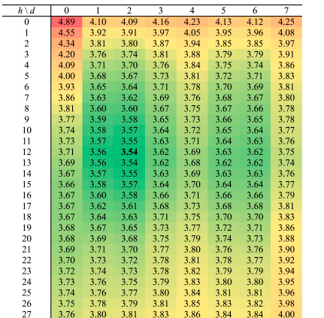
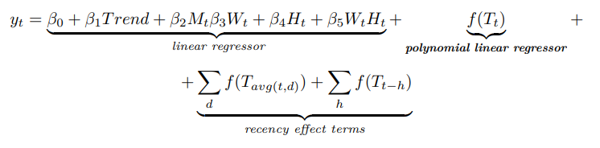
The Recency Effect
Article: “Electric load forecasting with recency effect: A big data approach” Pu Wang, Bidong Liu, Tao Hong
https://www.sciencedirect.com/science/article/pii/S0169207015001557?via%3Dihub
Uses the same data (excluding zone 9)
Basically a regression model:
MAPE stats for tuning h and d hyperparameters of the model of the left

Slide 11

The Shiny App
To visualize and analyse the time series
Temperature/Energy demand
Compare zone loads and station temperatures
See stats for some zones/ some stations
See overall stats
3D visualizations
Fourier analysis
Make automatic Forecast using trained models
Runs locally, once all the libraries are installed
Instructions in README

Slide 12
Problem Formulation
Problem 1: Given a time series input X of N hours (X∊R^{1xN}) to predict the values Y for the next M hours (Y∊R^{1xM})
Problem 2: Given a time series with a gap Y of M hours (Y∊R^{1xM}), use the existing time series X of length N hours (X∊R^{1xN}) to predict the gap values.
The models were tested on three tasks (M = 1h, 24h and 168h)

Slide 13
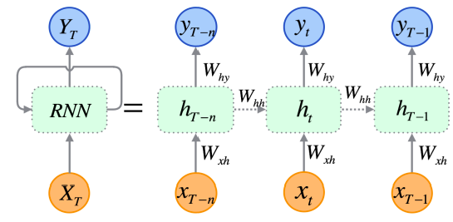
Recurrent neural networks (RNN)
Pro's
Keeps memory
Con's
Exploding and vanishing gradients problem
Complex to train

Slide 14
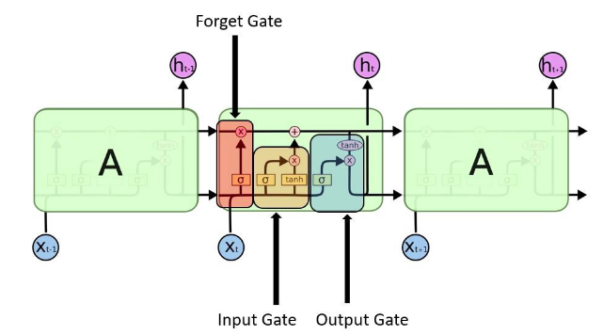
Long short-term memory (LSTM)

Slide 15
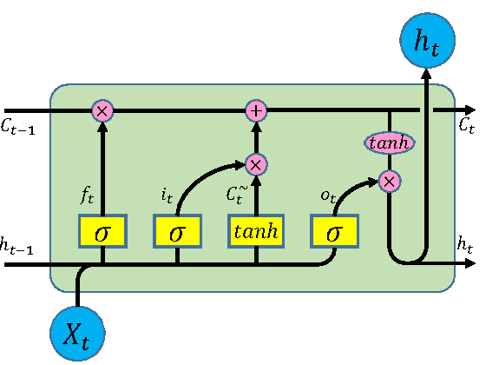
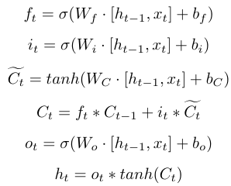
Long short-term memory (LSTM)

Slide 16
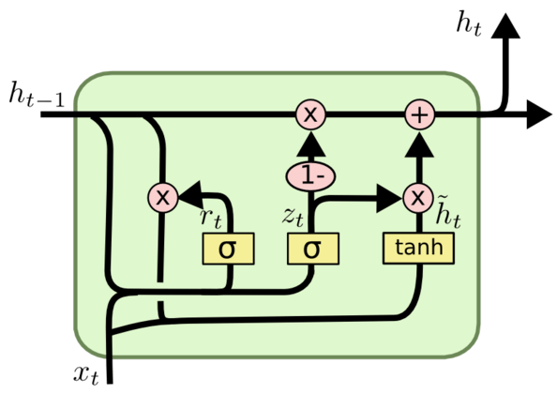
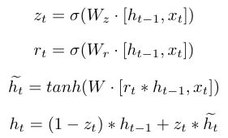
Gated recurrent unit (GRU)

Slide 17
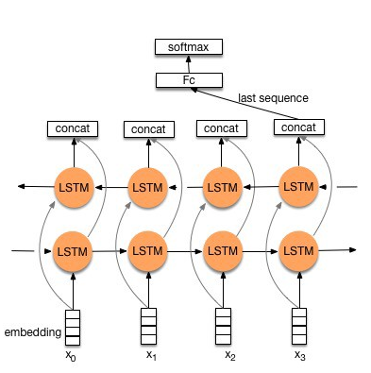
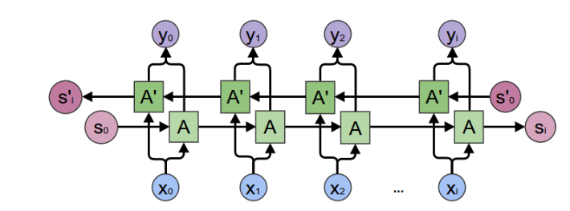
Bidirectional LSTM

Slide 18
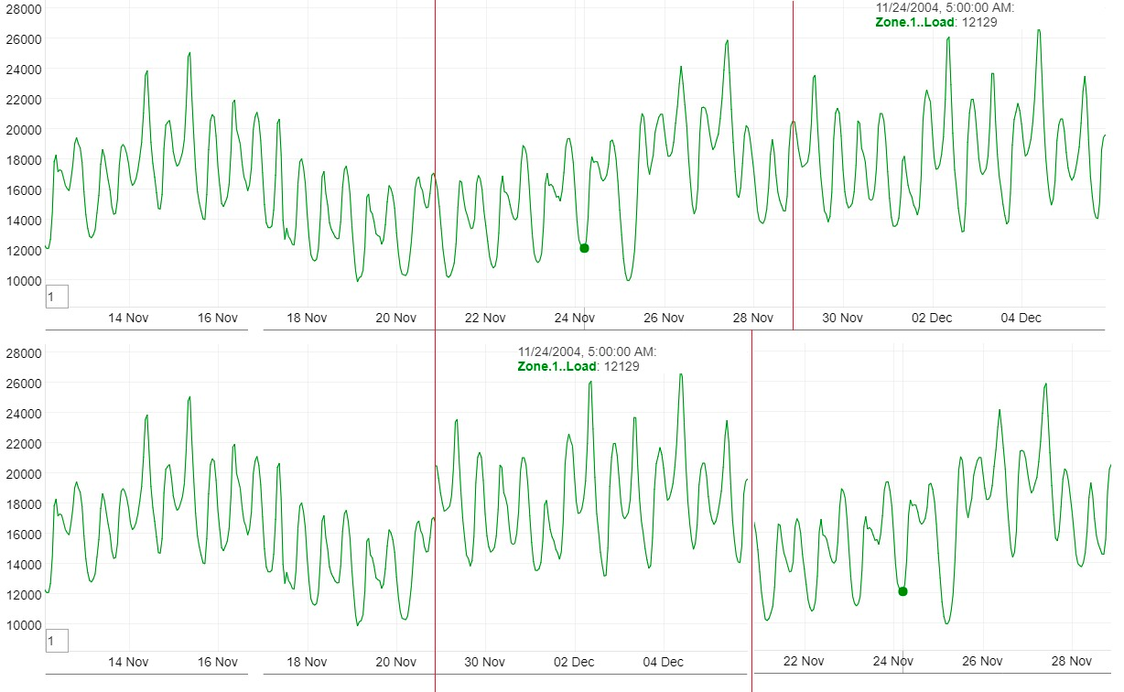
Another approach with Bidirectional LSTM

Slide 19
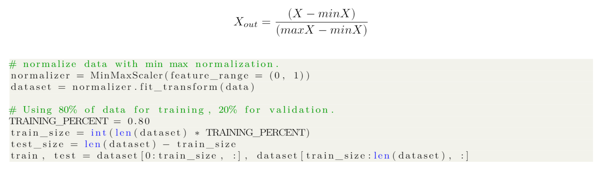
Data Pre-Processing
Notes:
It will be beneficial to normalize your training data. Having different features with widely different scales fed to your model will cause the network to weight the features not equally. This can cause a falsely prioritisation of some features over the others in the representation.

Slide 20
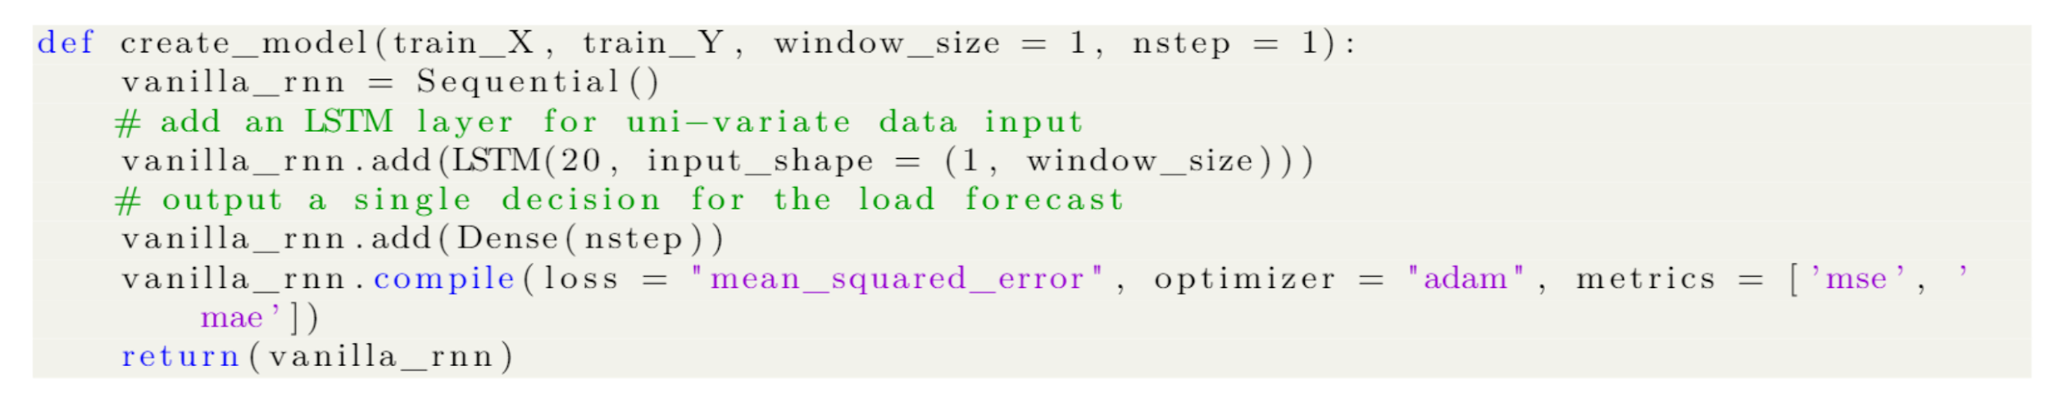
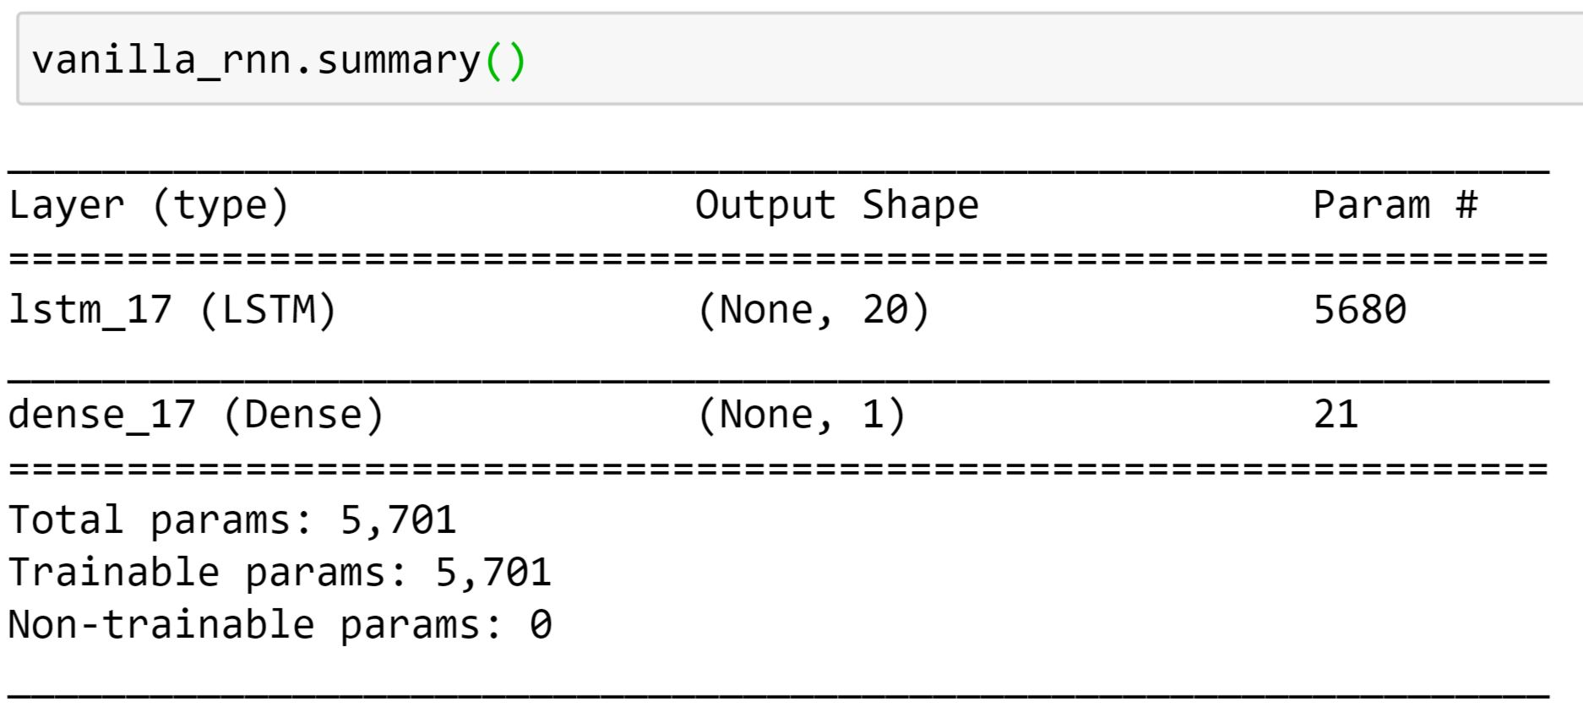
Keras Model Definition

Slide 21
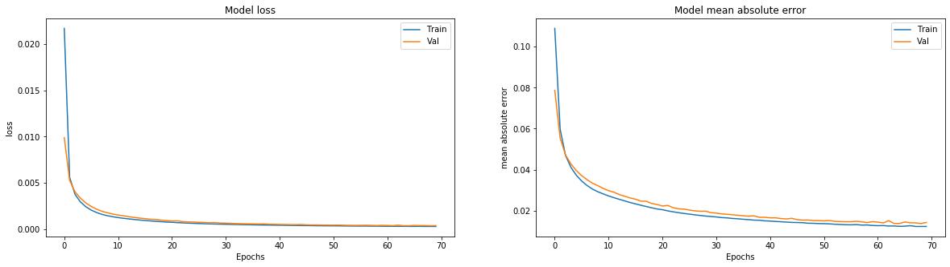
Keras Model Training

Slide 22
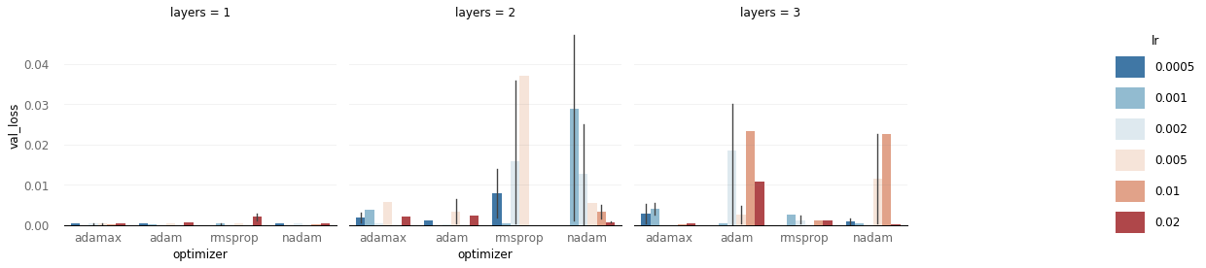
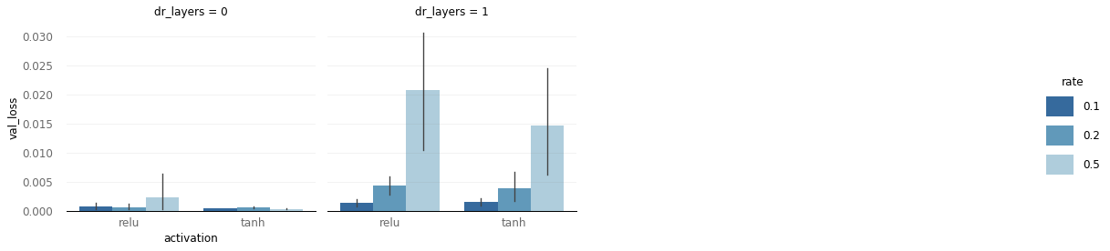
Hyper-Parameter Tuning

Slide 23
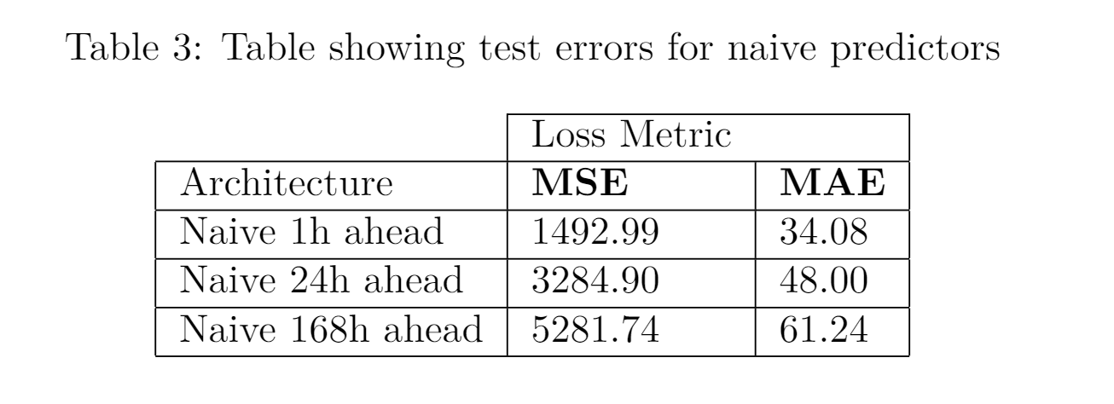
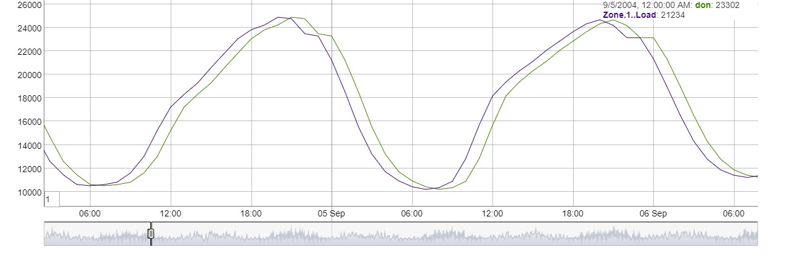
Naive Predictors

Slide 24
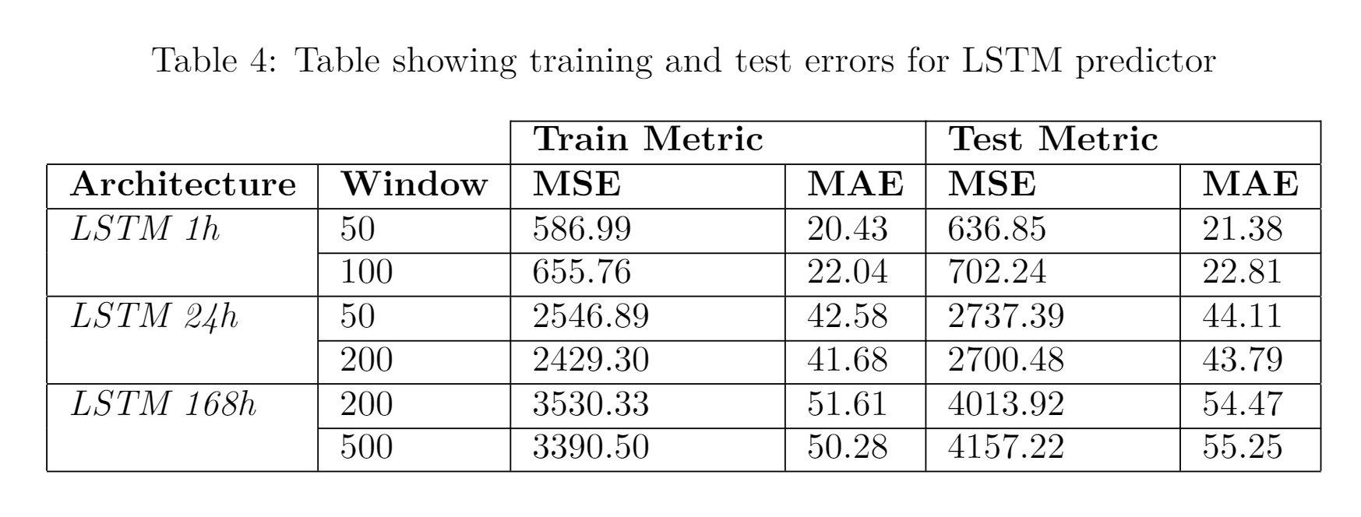
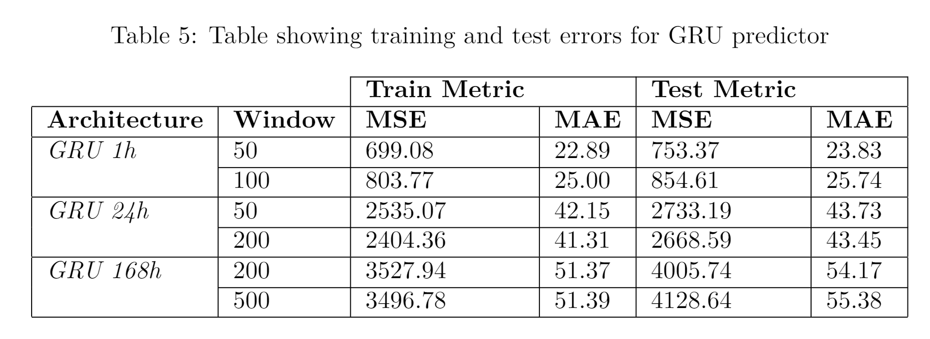
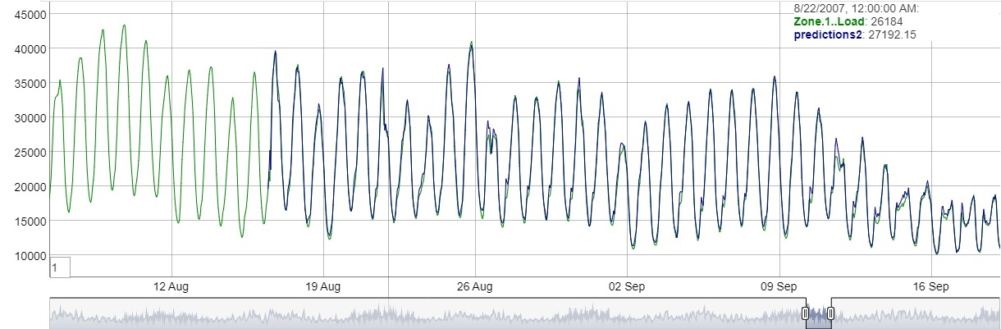
LSTM & GRU

Slide 25
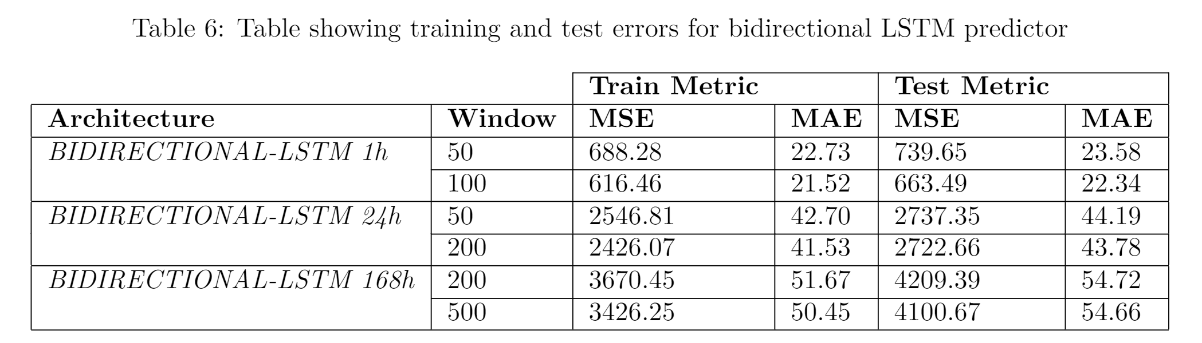
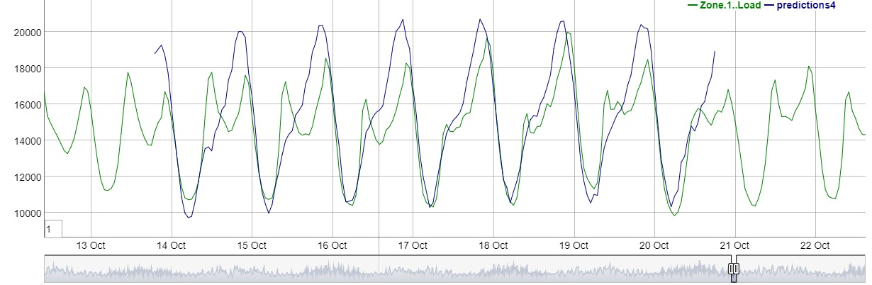
Bidirectional LSTM for Future Prediction

Slide 26
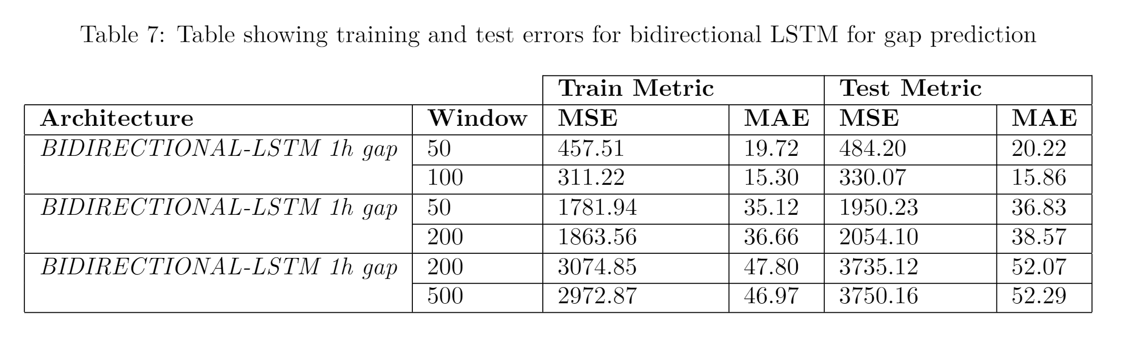
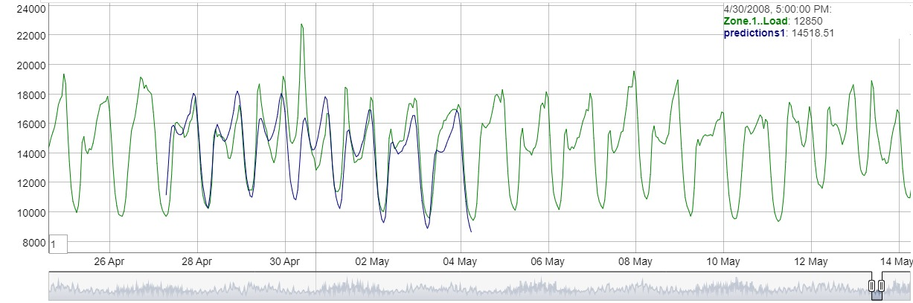
Bidirectional LSTM for Gap Prediction

Slide 27
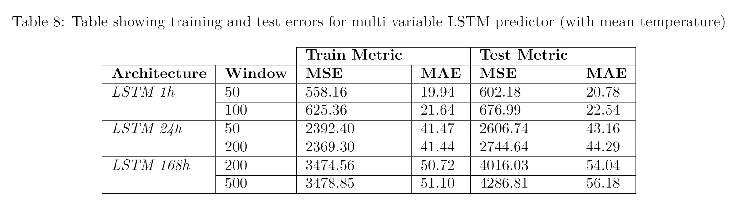
Multivariate LSTM with Temperature Data

Slide 28
Conclusion
GRU is the best performing model on our future prediction task.
Gap prediction can be tackled by using bidirectional LSTM.
Future work
CNN LSTM
Alternative implementation for gap prediction

